Slide 1
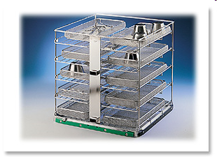
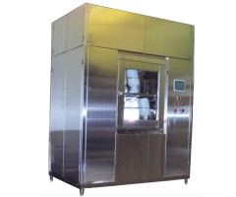
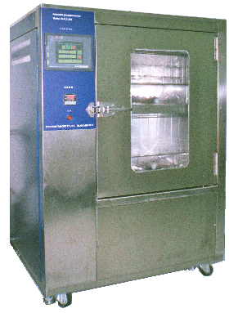
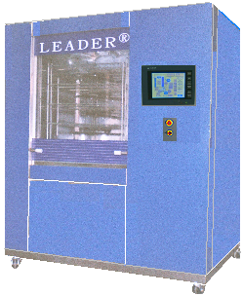
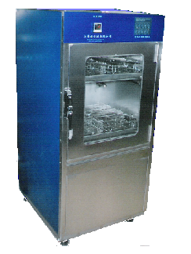
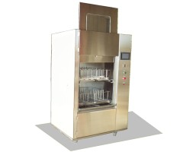

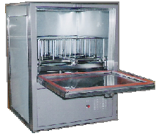
LEADER® MULTICHAMBER
MEDICAL TUNNEL WASHER
LEADER is a professional manufacturer Backed up by 30 years experience in the Asia area of laboratory, pharmaceutical and medical washing / disinfection. So, LEADER has designed ranges of professional washing machines intended to meet all your requirements
CE
TEL:2658-7810
FAX:2658-7801
E-mail:
leador.washer@msa.hinet.net
http: \\www.leader21tw.net
LEADER ULTRASONIC CO., LTD
TEL：02-2658-7810 FAX：02-2658-7801
E-mail：leador.washer@msa.hinet.net
1

Slide 2


LEADER® MULTICHAMBER MEDICAL TUNNEL WASHER
LEADER® LD-570T
The LEADER® LD-570T are especially designed for the CSR and offers due to the modular construction high efficient cleaning and best reprocessing results.
The machine can be made fit for purpose out of 1 – 4 independent elements: Cleaning-, Disinfection-, Ultrasound- and Drying units.
LEADER® LD-570T
Temperature
Thermal disinfection
Good mechanical efficient Cleaning
Pump spray and ultrasonic cleaning
Time
Wash time and process。
Chemical Dosing system Four liquid dosing pumps
LEADER® LD-570T：
Key features
> Up to 15 instrument trays [485x250x50mm]
> RS232 interface for printer- or PC connection
> Touch Monitor operator panel with 40 adjustable cleaning cycles
> Automatic powered full glass door (s)
> Washing and thermal disinfecting temperature adjustable up to [93ºC]
> Temperature monitoring by two independent PT-100 probes
> Exhaust steam condenser optional 。
Range of Use:
The machine is designed for cleaning the following parts:
1. glassware
2. drums and containers
3. surgical instruments.
4. MIS-Instruments
5. Rigid Endoscopes
6. Surgical Shoes
7. Ophthalmology
8. Anesthesia
2

Slide 3
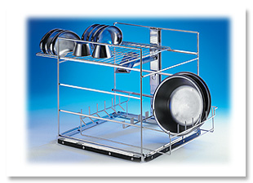
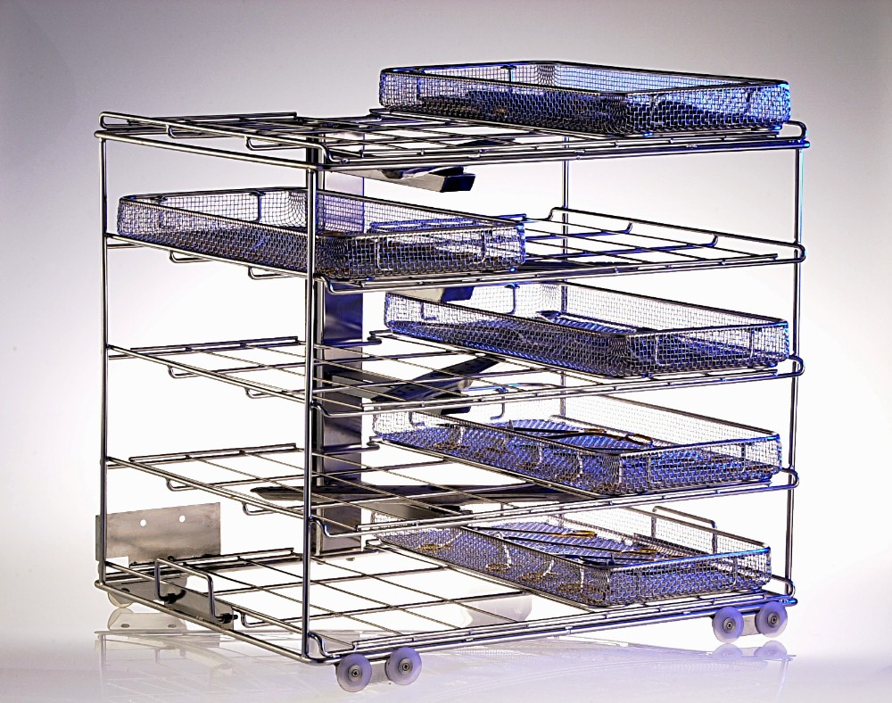
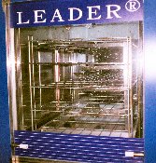
LEADER Medical Washer Disinfector LEADER® LD-570T
BASIN BASKETAND INSTRUMENT BASKET( Up to 15 DIN trays)
Extensive variants of equipment
-One-, Two-,Three-, Four-, module unit, vertical sliding doors
- Ultrasonic cleaning chamber
- Steam or electrical heating
- Monitoring of pump pressure, temperature, conductivity etc.
- Use of hollow jets with contact coupler to the basket (GMP rinse)
- High capacity HEPA filtered drying system
- Barcode reader for automatic basket identification
- Wide variety of baskets, customer specific manufacture
- Extensive automation, conveyors etc.
- Execution in ex-protection
glass door allow visual inspection of wash spray operation
3

Slide 4
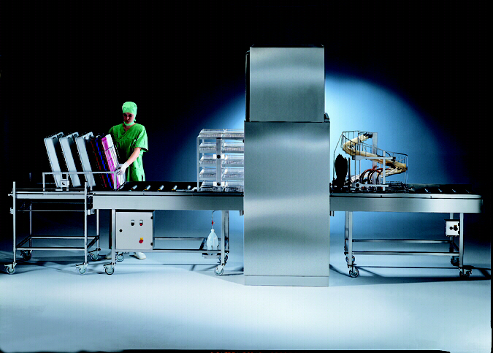
LEADER Medical Washer Disinfector LEADER® Model: LD-570T (1module)
Dimensions complete machine :
External: 1500/1850/3180 mm (W/H/L). (2700mmwith open door)
Wash chamber : 700/880/890 mm (W/H/D).
Capacity
15 DIN-Instrument baskets
Automatic powered full glass door allow visual inspection of wash spray operation
Dimensions complete machine :1500/1850/3180 mm (W/H/L). (2700mmwith open door) Extendable with automatic loading and unloading options
Control system
easy and user-friendly operation
Control system
PLC Controller with Color touch screen monitor with RS232 interface for printer-
or PC connection
Dosing system
Diaphragm pump 12 L/h
Sucking lance with level control and alarm function for
Transfer trolley In SS 304, electro-polished

Slide 5
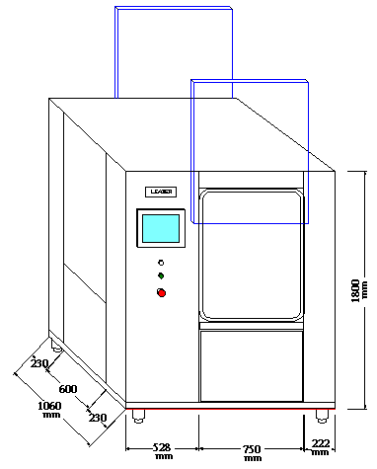
LEADER Medical Washer Disinfector LEADER® LD-570T
Cold Water (1)**
3/4" NPT, 2-5 bar. Coldwater must be supplied at 16°Cminimum. Flow rate –25 L/min
Warm Water (2)**
3/4" NPT, 2-5 bar. Hotwater must be supplied at (43°C) minimum. Flow rate –25 L/min.
Pure or DI Water (3)** †
3/4" NPT, (2-5 bar. Maximum flow rate –25 L/min.
Recommended minimum specific
resistivity of 0.1 megohm per cm.
Drain (4)**
1-1/2" NPT. A 2" (51 mm) OD floor
drain is recommended.
Electricity (5)**
電源、電壓：208V/3P/4W 27A
Steam (6)** †
1/2" NPT, 3-5 bar
Consumption – 45-60 lb/hr. Peak flow rate – 220 lb/hr.
Condensate Return (7)** †
1/2" NPT. Peak – 0.4 gpm.
Air (9)†
1/4" NPT (8 mm), 44-87 psig (4-6 bar)
oil-free compressed air
Ventilation (8)**
3.5" (89 mm) OD vent connection.
Maximum flow rate – 206 scfm (350 m3/h). Maximum Temperature 194°F (90°C).
6" (152 mm) if condenser backflow preventer is ordered.
LEADER ULTRASONIC CO., LTD
TEL：02-2658-7810 FAX：02-2658-7801
E-mail：leador.washer@msa.hinet.net
5

Slide 6
LEADER Medical Washer Disinfector LEADER® Model: LD-570-1T (1module)
Dimensions complete machine :
外觀尺寸：1060×2030×830mm（W×H×D） (2700mmwith open door)
Wash chamber : 700/880/640 mm (W/H/D).
籃架尺寸：610×660×610mm（W×H×D）
Automatic powered full glass door allow visual inspection of wash spray operation
LEADER® LD-570-1T(單腔式)
Dimensions complete machine :1060/2030/2480 mm (W/H/L).(配合現場組裝)
Extendable with automatic loading and unloading options
安全性：
1.具有安全鎖：循環周期在門完全關閉時才會啟動。如門在循環周期
中打開，則所有之服務皆會關閉，且循環也會停止。
2.電動門具有安全感應器，可偵測位於門道上之障礙物，並將門回縮。
3. PLC Controller with Color touch screen monitor with RS232 interface for printer-
or PC connection
4.PRINTER: 自動收捲式列表機可列印所有清洗參數，並可自動回捲列表紙，作
為日後參考之完整紀錄。
5.安全設定：需有2組密碼鎖才能更改清洗設定值。
配件：3層清洗籃架 1個、台製推車2台。
6

Slide 7
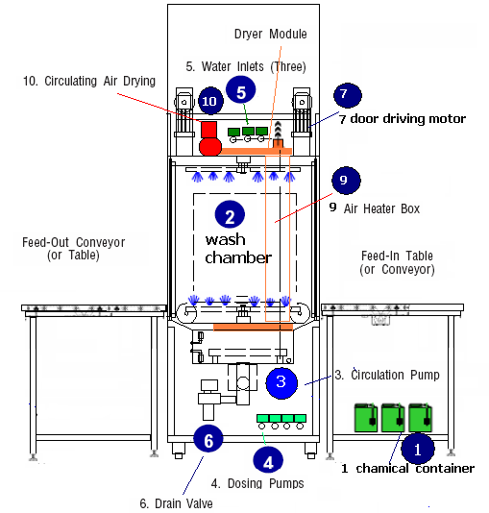
LEADER Medical Washer Disinfector LEADER® LD-570-1T
Internal wash chamber diagram
LEADER® LD-570-1T(單腔式)
輸送系統 (如規劃圖)
LEADER ULTRASONIC CO., LTD
TEL：02-2658-7810 FAX：02-2658-7801
E-mail：leador.washer@msa.hinet.net
7

